Slide 1


Intro to Signal Processing
Rensselaer Polytechnic Institute
Notes:
Title slide:
Introduce everyone and engineering ambassadors

Slide 2
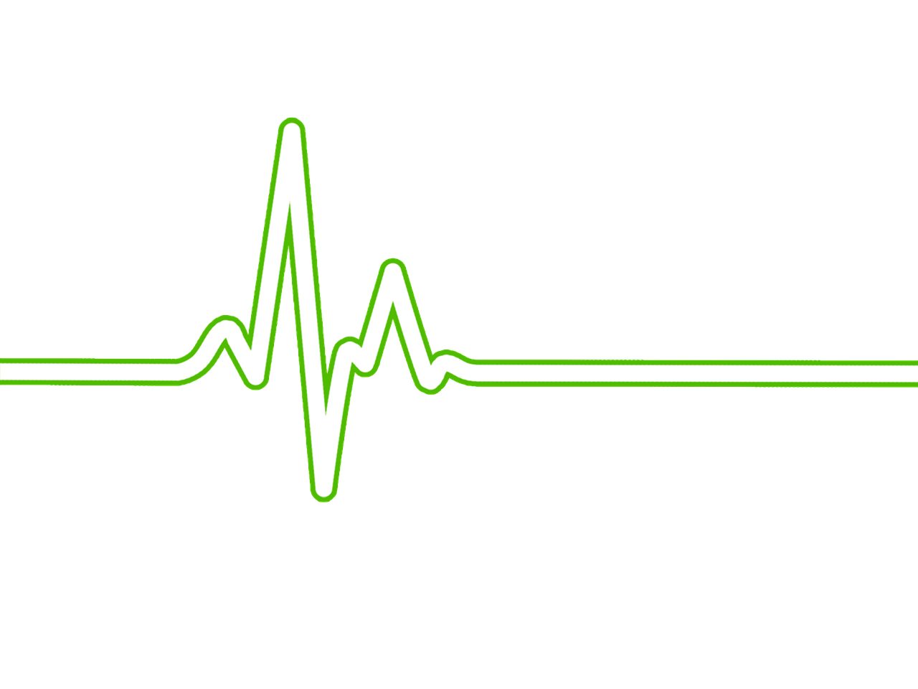
What do you remember from Week 1?
Notes:
Now that we know what an ECG is we can look at how this technology works. We will do this by amplifying a single wave from the output

Slide 3
Data science is continuously becoming more important in medical diagnostics.
1995
2013

Slide 4
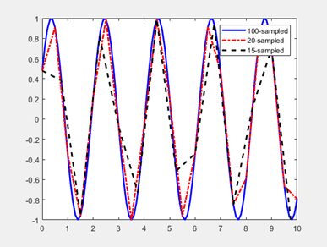
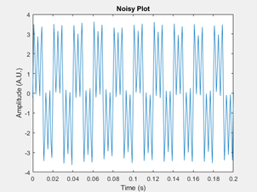
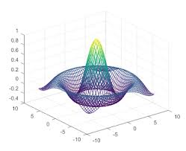
Signal Processing: Sampling Frequency
Signal Processing: Filtering
Introduction to Octave

Slide 5
Signal Processing: Sampling Frequency

Slide 6
Sampling frequency here
Overlay the different graphs
Need grad students for correct graphs

Slide 7
Signal Processing: Filtering

Slide 8
Filtering is here
Overlay the different graphs
Need grad students for correct graphs
Same idea as previous section

Slide 9
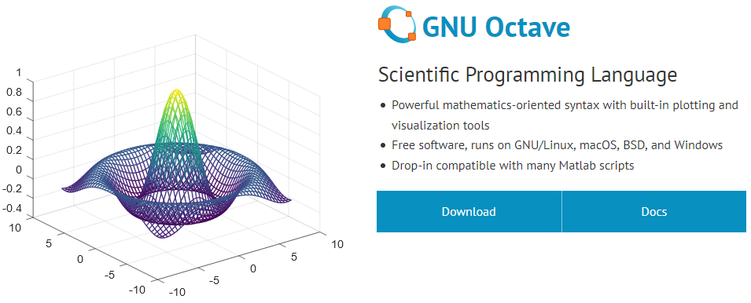
Octave is a coding platform compatible with MATLAB

Slide 10
Hands-on explanation

